Slide 1
Applied Data Science L1. Learning from Data. Overview of Machine Learning/ Data Science approaches.
Irina Mohorianu
Head of Bioinformatics/ Scientific Computing @CSCI

Slide 2
Structure of the module. Requirements.
Learning from data
L1 Learning from data. Overview of Machine Learning/ Data Science approaches
L2 Learning from data. Cross-validation. Data pre-processing
Data Science toolkit. Python Scientific Computing Ecosystem
L3 Data Science toolkit. Scikit learn. Visualisation
L4 Data Science toolkit. NumPy. Matplotlib
L5 Data Science toolkit. SciPy. Help and documentation
Supervised Learning
L6 Regression 1 [linear, logistic]
L7 Regression 2 [+ overfitting/ underfitting and regularisation approaches]
L8 Classification
L9 k nearest neighbours
L10 Support vector machines
L11 Kernelisation
W4. Exercise sheet 1.
Cross-validation. Linear Regression
W5/W6. Exercise sheet 2.
kNNs, SVMs

Slide 3
Structure of the module. Requirements.
Supervised Learning
L12 Tree based models
L13 Ensemble methods. Random Forests
L14 Ensemble methods. Bagging
L15 Ensemble methods. Boosting
AdaBoost; Stack methods will also be briefly discussed.
Unsupervised learning
L16 Dimensionality reduction. Linear methods. PCA
L17 Dimensionality reduction. Non-Linear methods. tSNE & UMAP
L18 Traditional clustering algorithms. Hierarchical clustering. K-means
L19 Modern clustering algorithms
Density based clustering. Graph based clustering
L20 Assessment of clustering outputs
Cluster-based methods and element centric methods
L21 Fuzzy clustering. C-means & consensus clustering
L22 Outlier detection
W7. Exercise sheet 3.
Tree based approaches
W8. Exercise sheet 4.
Dimensionality Reduction. Clustering

Slide 4
Structure of the module. Requirements.
Neural Networks
L23 Neural networks 1
L24 Neural networks 2
Non-examinable.
Assessments:
67% Assessed coursework (end of term).
focused on a large, curated input with hundreds of samples and measurements
comprising three parts – covering aspects of both supervised and unsupervised learning
33% Written exam (January 2024)

Slide 5
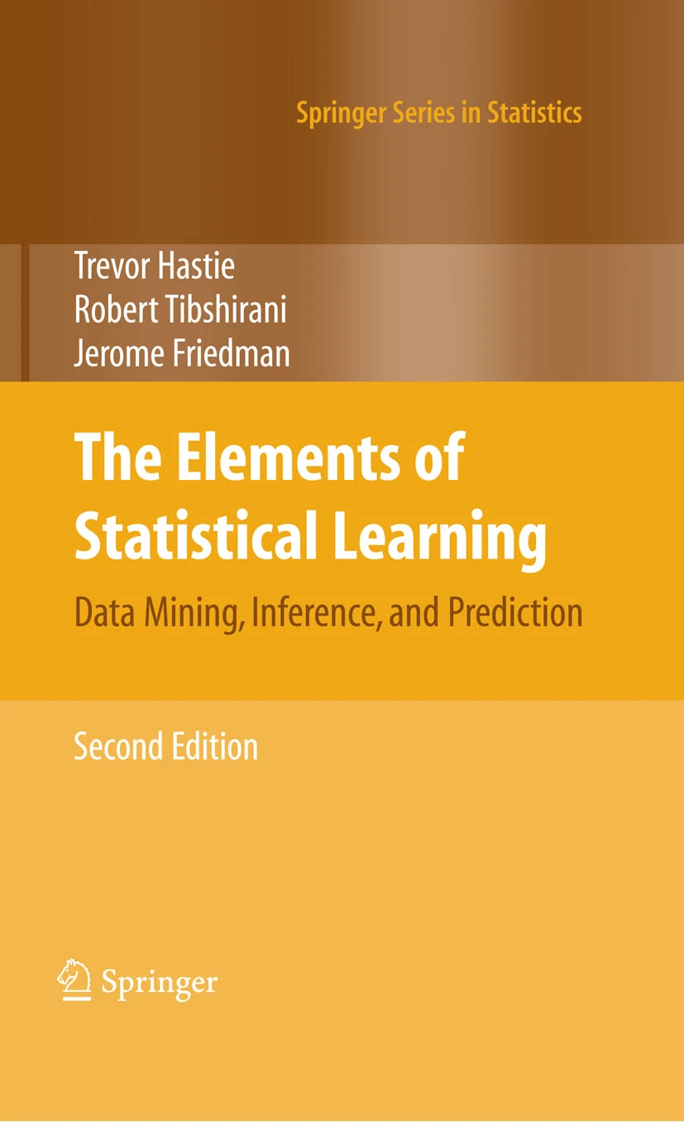
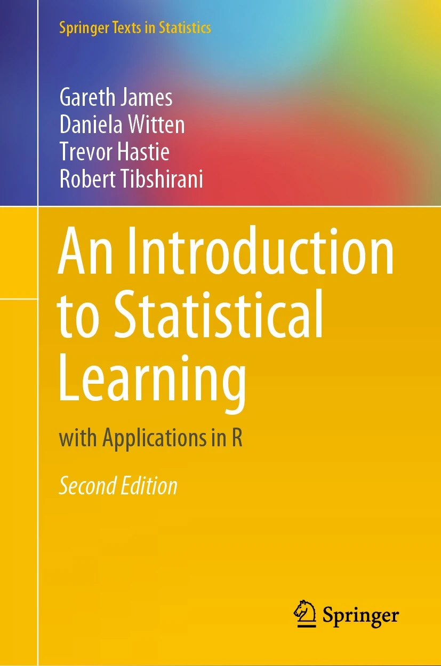
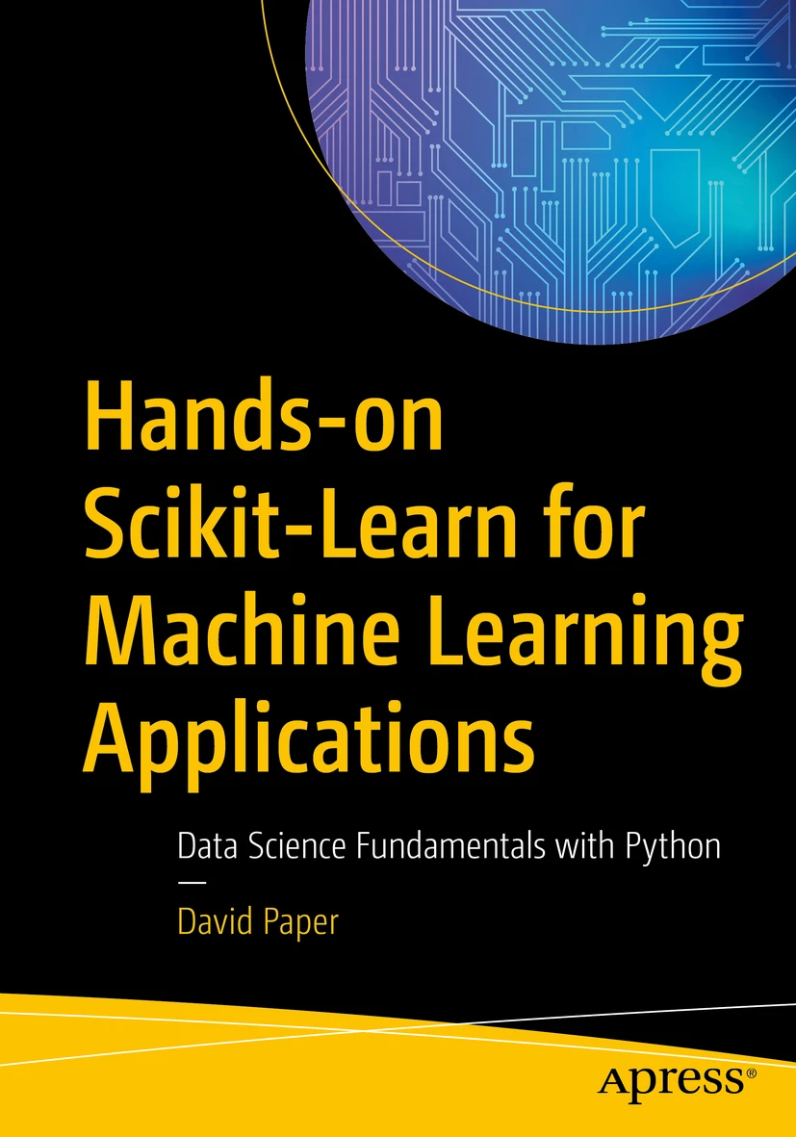
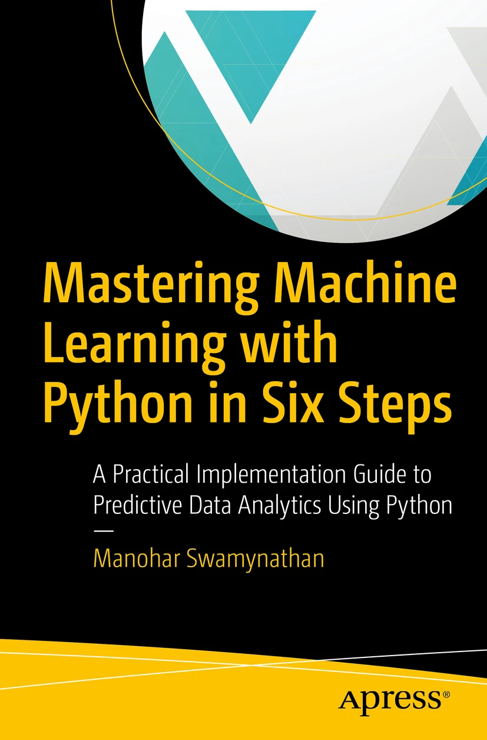
Useful references
James, Witten, Hastie, Tibshirani Introduction to Statistical Learning
Python: https://www.statlearning.com/resources-python
R: https://www.statlearning.com/
Hastie, Tibshirani, Friedman Elements of Statistical Learning
https://link.springer.com/book/10.1007/978-0-387-84858-7
David Paper Hands-on Scikit-Learn for Machine Learning applications
Data Science Fundamentals with Python
https://link.springer.com/book/10.1007/978-1-4842-5373-1
M Swamynathan Mastering Machine Learning with Python in Six Steps
A practical implementation guide to predictive data analysis using Python.
https://link.springer.com/book/10.1007/978-1-4842-2866-1
[two editions are available]
This list is not exhaustive.

Slide 6
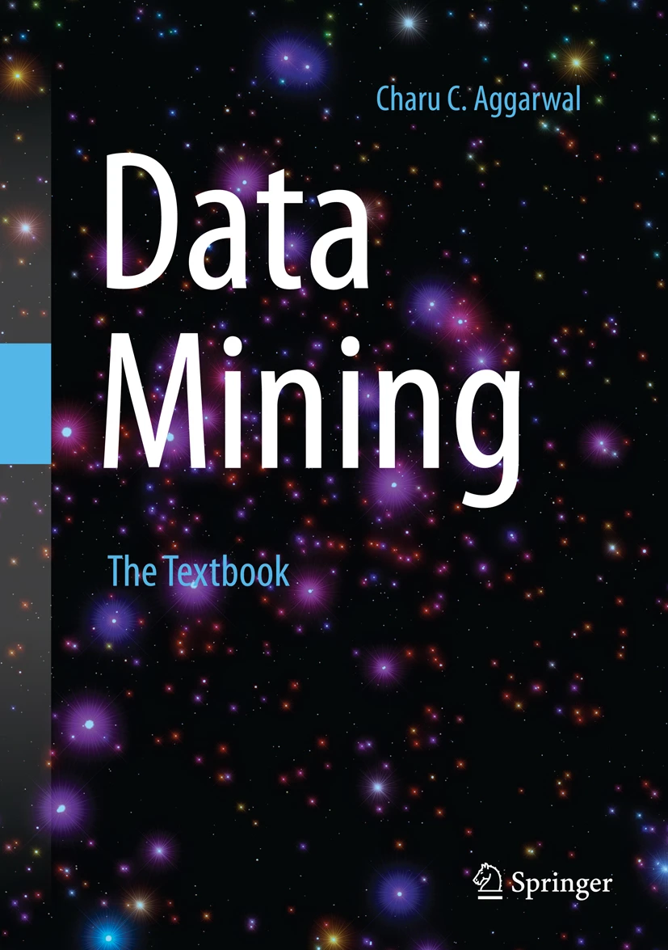
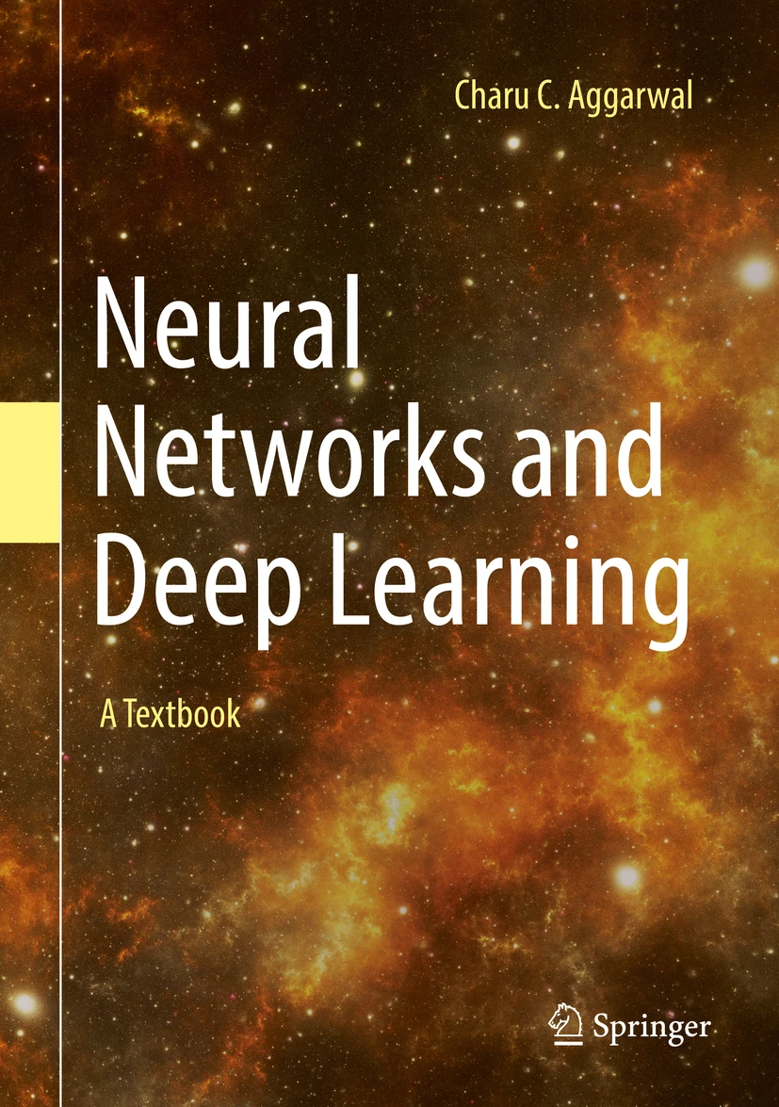
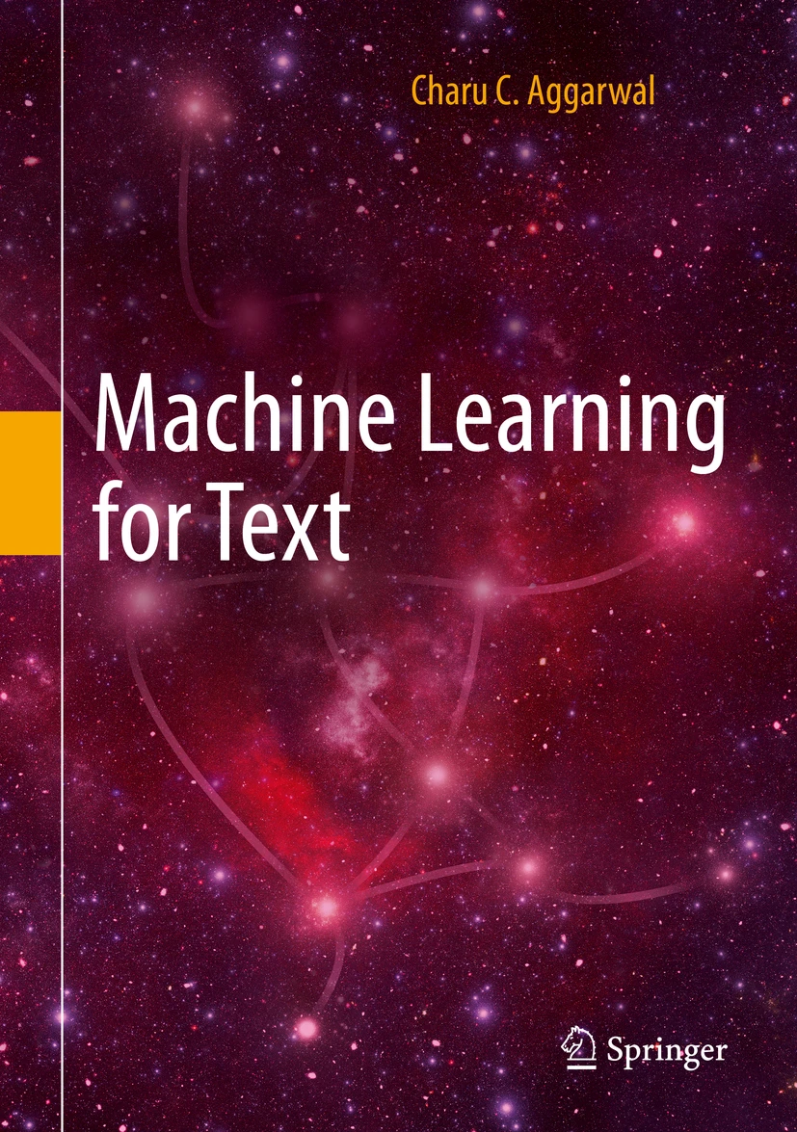
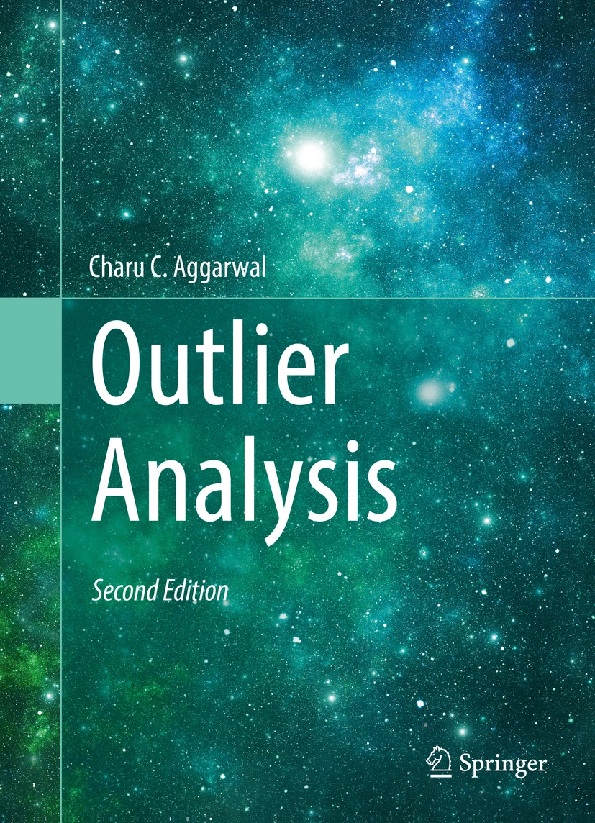
Useful references
Aggarwal Neural Networks and Deep Learning
https://link.springer.com/book/10.1007/978-3-319-94463-0
Aggarwal Data mining
https://link.springer.com/book/10.1007/978-3-319-14142-8
Aggarwal Machine Learning for Text
https://link.springer.com/book/10.1007/978-3-319-73531-3
Aggarwal Outlier Analysis
https://link.springer.com/book/10.1007/978-3-319-47578-3
This list is not exhaustive.

Slide 7
What is Applied Data Science/ Machine Learning?
What do you see?
We need to classify the pictures with a dog and the ones with the muffin.
Or do we need to partition the images and manually annotate some of them?

Slide 8
What is Applied Data Science/ Machine Learning?
New York Times reported in 1958 that the invention was the beginning of a computer that would “be able to walk, talk, see, write, reproduce itself and be conscious of its existence”

Slide 9
What is Applied Data Science/ Machine Learning?

Slide 10
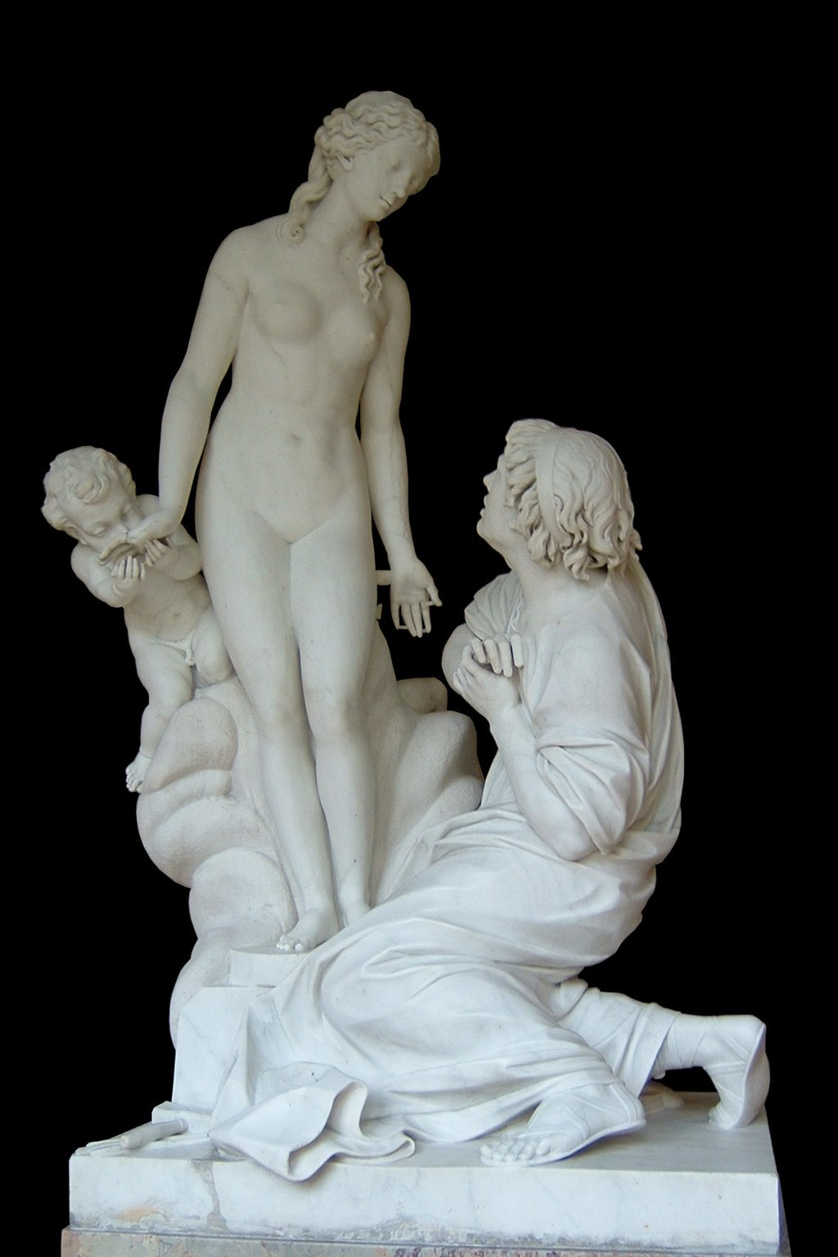
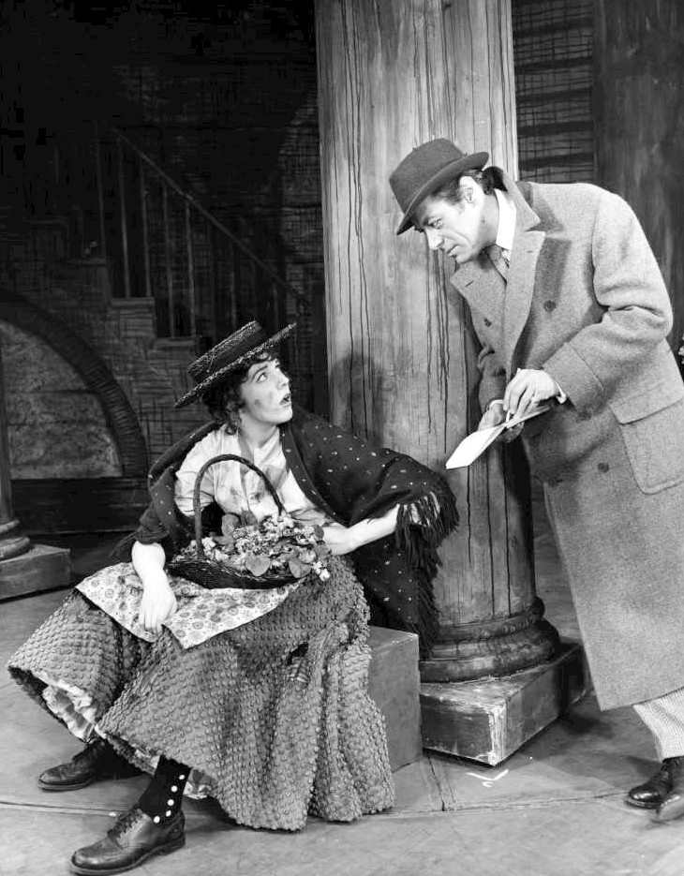
Artificial Intelligence vs Machine Learning
Greek Mythology
Pygmalion of Cyprus sculpts a marble statue of Galateea.
He falls in love with the sculpture and it comes to life.
George Bernard Shaw’s Pygmalion
Higgins teaches Eliza Doolittle to speak Queen’s English
The rain in Spain stays mainly in the plain.
Eliza is the first AI program.
Weizenbaum, MIT

Slide 11



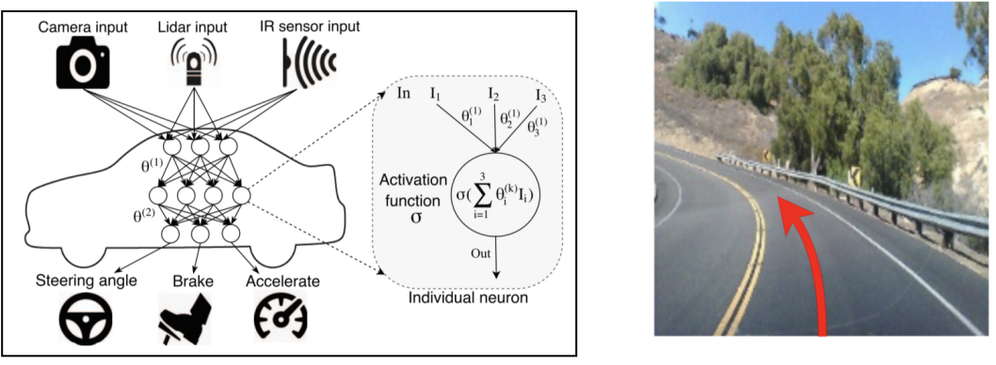
Artificial Intelligence vs Machine Learning
We can argue that today AI is ubiquitous.
Automated searches
Speech recognition
Autonomous vehicles

Slide 12
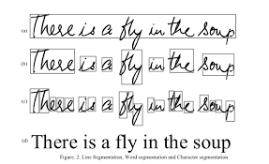
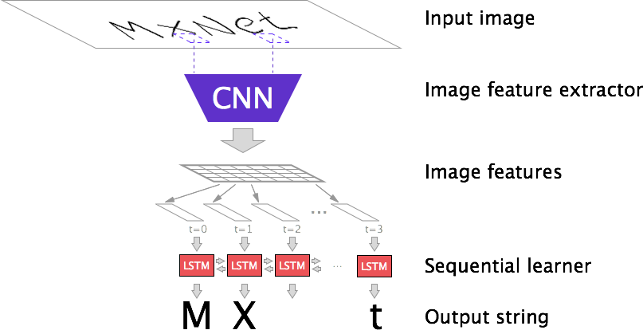
Artificial Intelligence vs Machine Learning
Hand writing recognition
Rule-based approaches, numerous exceptions
Relies on training data
Cannot be done without Machine Learning

Slide 13
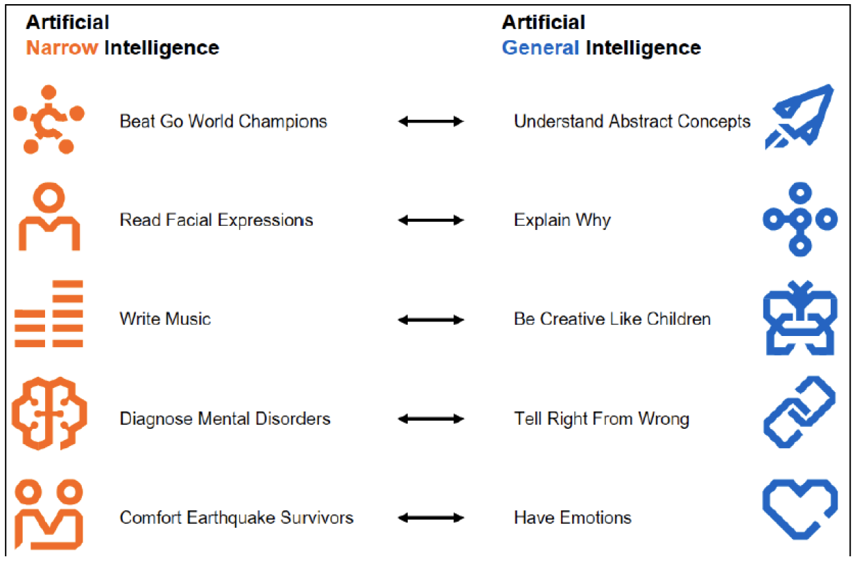
AI paradox
Hard problems for people are easy for AI
Easy problems for people are hard for AI

Slide 14
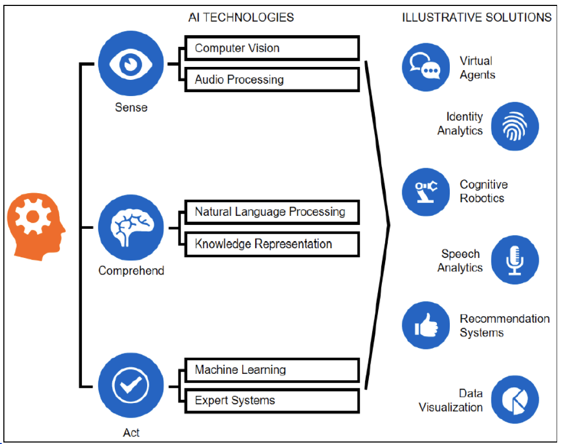
Where does the Machine Learning fit?
Tasks requiring intelligence:
Reasoning
puzzles, judgements
Planning
sequences of actions
Learning
extracting information from data
Natural language
Integrating skills

Slide 15
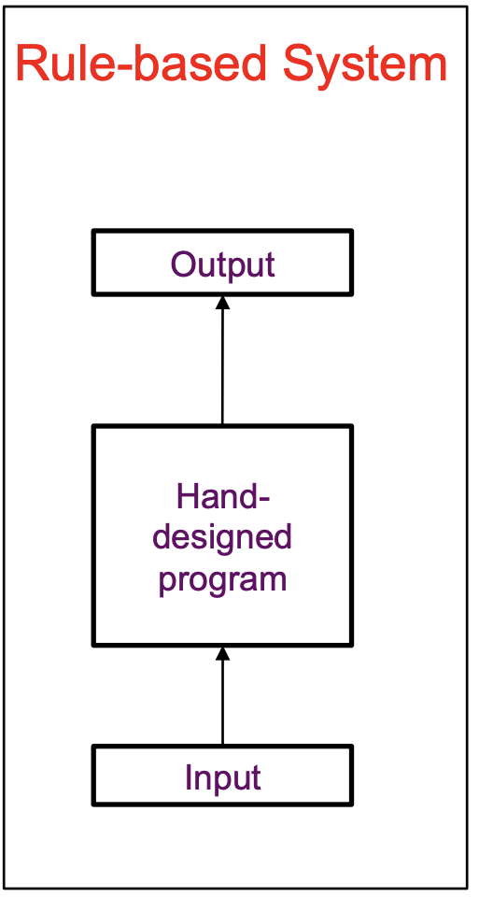
Knowledge based AI
Unwieldly process
Requires human experts (time and knowledge)
People struggle to formalise rules with enough complexity to capture variability
Machine Learning Approach
Data collection (samples)
Model selection
Parameter estimations (values, distributions)
Training the model
Inference (response to queries)
Testing the model
(decision inference)

Slide 16
What is Machine Learning?
Machine Learning (ML) is generating abstract hypotheses (models) based on data which can be later used predict results on new data.
Types of ML:
[1] Supervised
[2] Unsupervised
[3] Semi-supervised
[4] Reinforcement learning

Slide 17
What is Machine Learning?
Based on Type of Data
[1] supervised, unsupervised, semi-supervises
[2] reinforcement learning
Types of ML:
[1] Supervised
[2] Unsupervised
[3] Semi-supervised
[4] Reinforcement learning
Based on Type of Output
[supervised learning]
[1] regression
[2] classification
Based on Type of Model
[1] generative
[2] discriminative

Slide 18
Types of Machine Learning Algorithms
Semi-supervised
learning
Source: Data Science Central

Slide 19
Common models used in Machine Learning
Separation of data point into classes.
Typical example: yes/no answers
Continuous numerical outcome.
Prediction of future values based on observed ones
Identification of important/ discriminative
features based on their relationship with the
target attribute.

Slide 20
Common models used in Machine Learning
Identification of outliers
Finding groups/ structure in the data
Finding rules associated with naturally
co-occurring terms
Selection of best features to describe a target attribute

Slide 21
DS/ML examples. AlphaFold

Slide 22
DS/ML examples. AlphaFold

Slide 23
DS/ML examples. AlphaFold

Slide 24
DS/ML examples. Chemistry example
Source: Rodrigues et al, A survey of Big Data and Machine Learning for Chemistry

Slide 25
DS/ML examples. Chemistry example
Source: Rodrigues et al, A survey of Big Data and Machine Learning for Chemistry

Slide 26
DS/ML examples. Physics example
Figures from Machine Learning and the physical science, Carleo et al

Slide 27
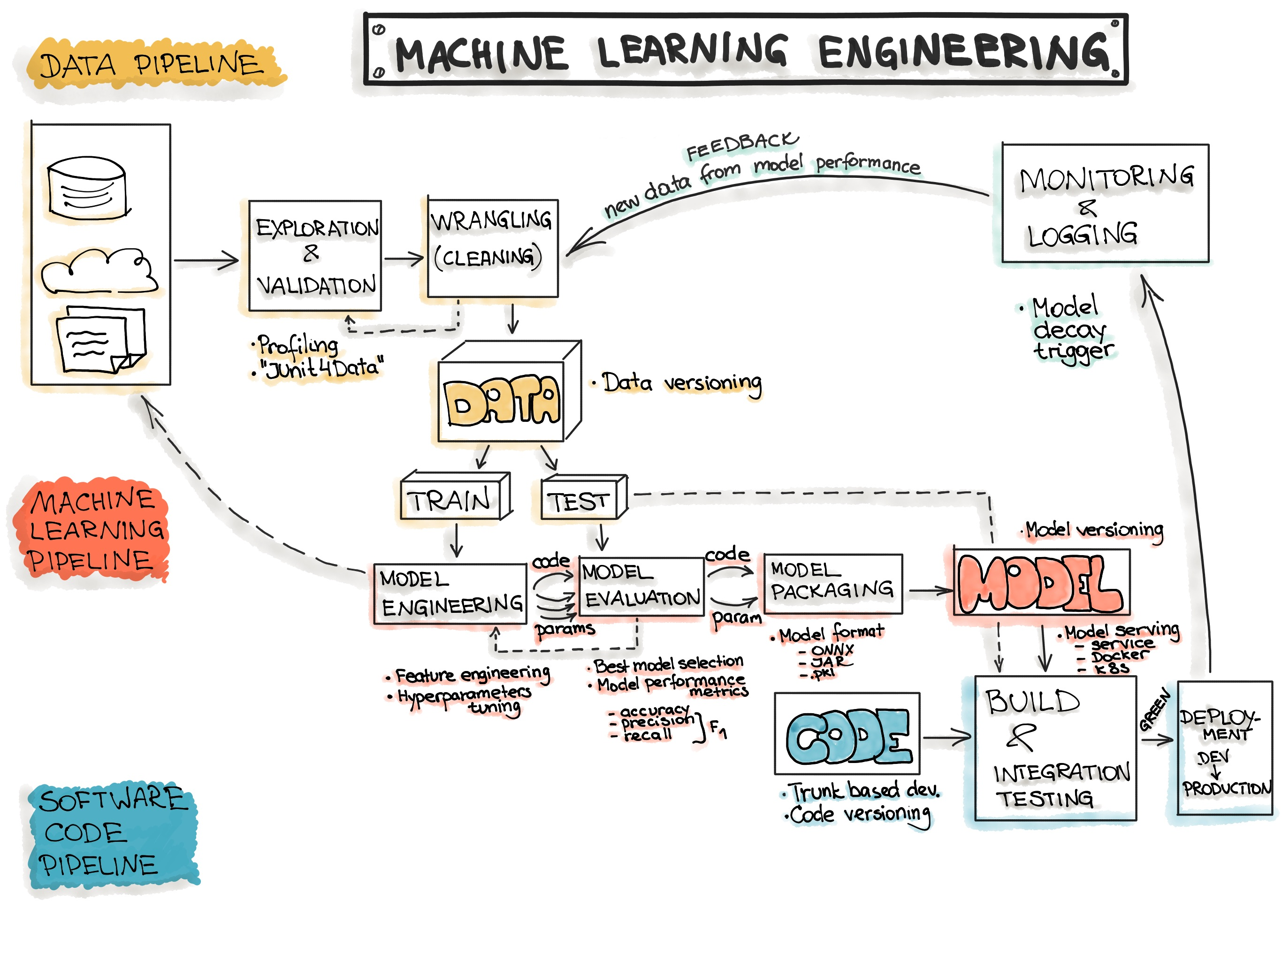
ML workflow
Copyright:
https://ml-ops.org/content/end-to-end-ml-workflow

Slide 28
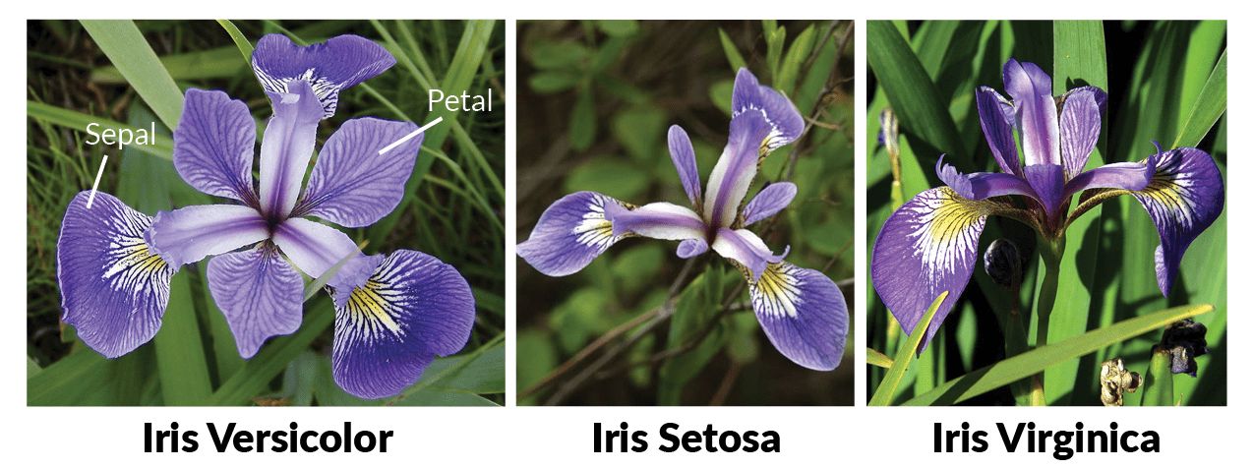
Iris dataset
Attribute Information:
1. sepal length in cm
2. sepal width in cm
3. petal length in cm
4. petal width in cm
5. class:
-- Iris Setosa
-- Iris Versicolour
-- Iris Virginica
Data Set Information:
This is perhaps the best known database to be found in the pattern recognition literature.
Fisher's paper is a classic in the field and is referenced frequently to this day.
The data set contains 3 classes of 50 instances each, where each class refers to a type of iris plant. One class is linearly separable from the other 2; the latter are NOT linearly separable from each other.
Predicted attribute: class of iris plant.

Slide 29
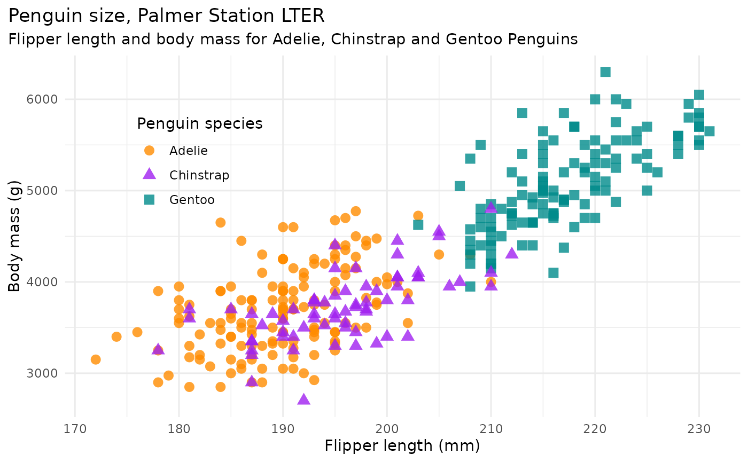
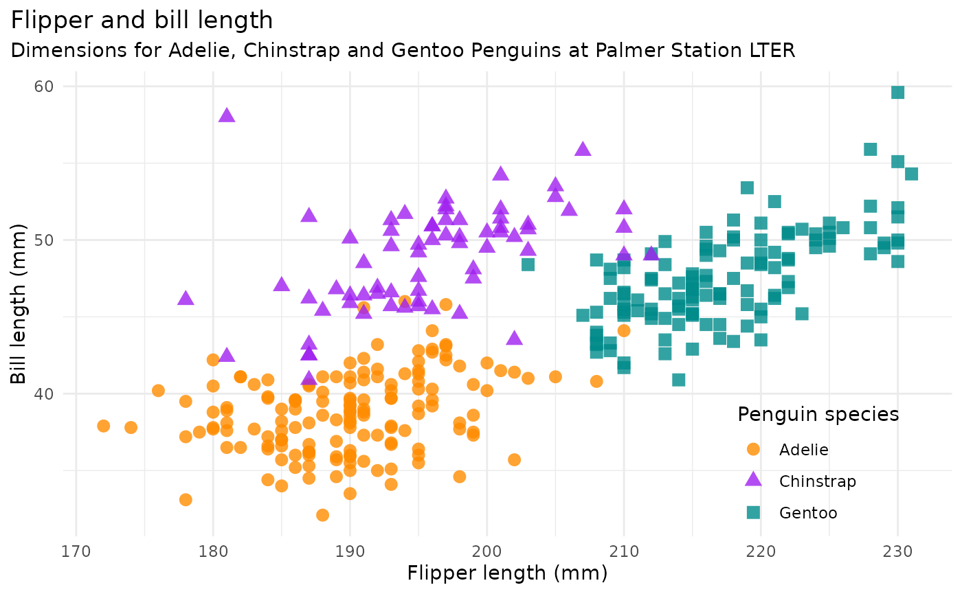
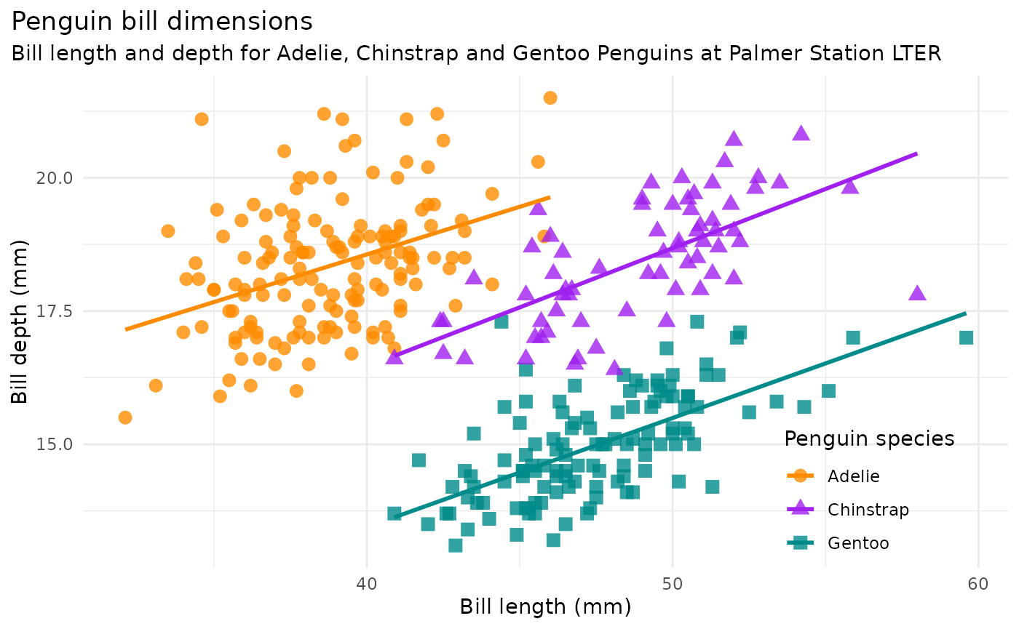
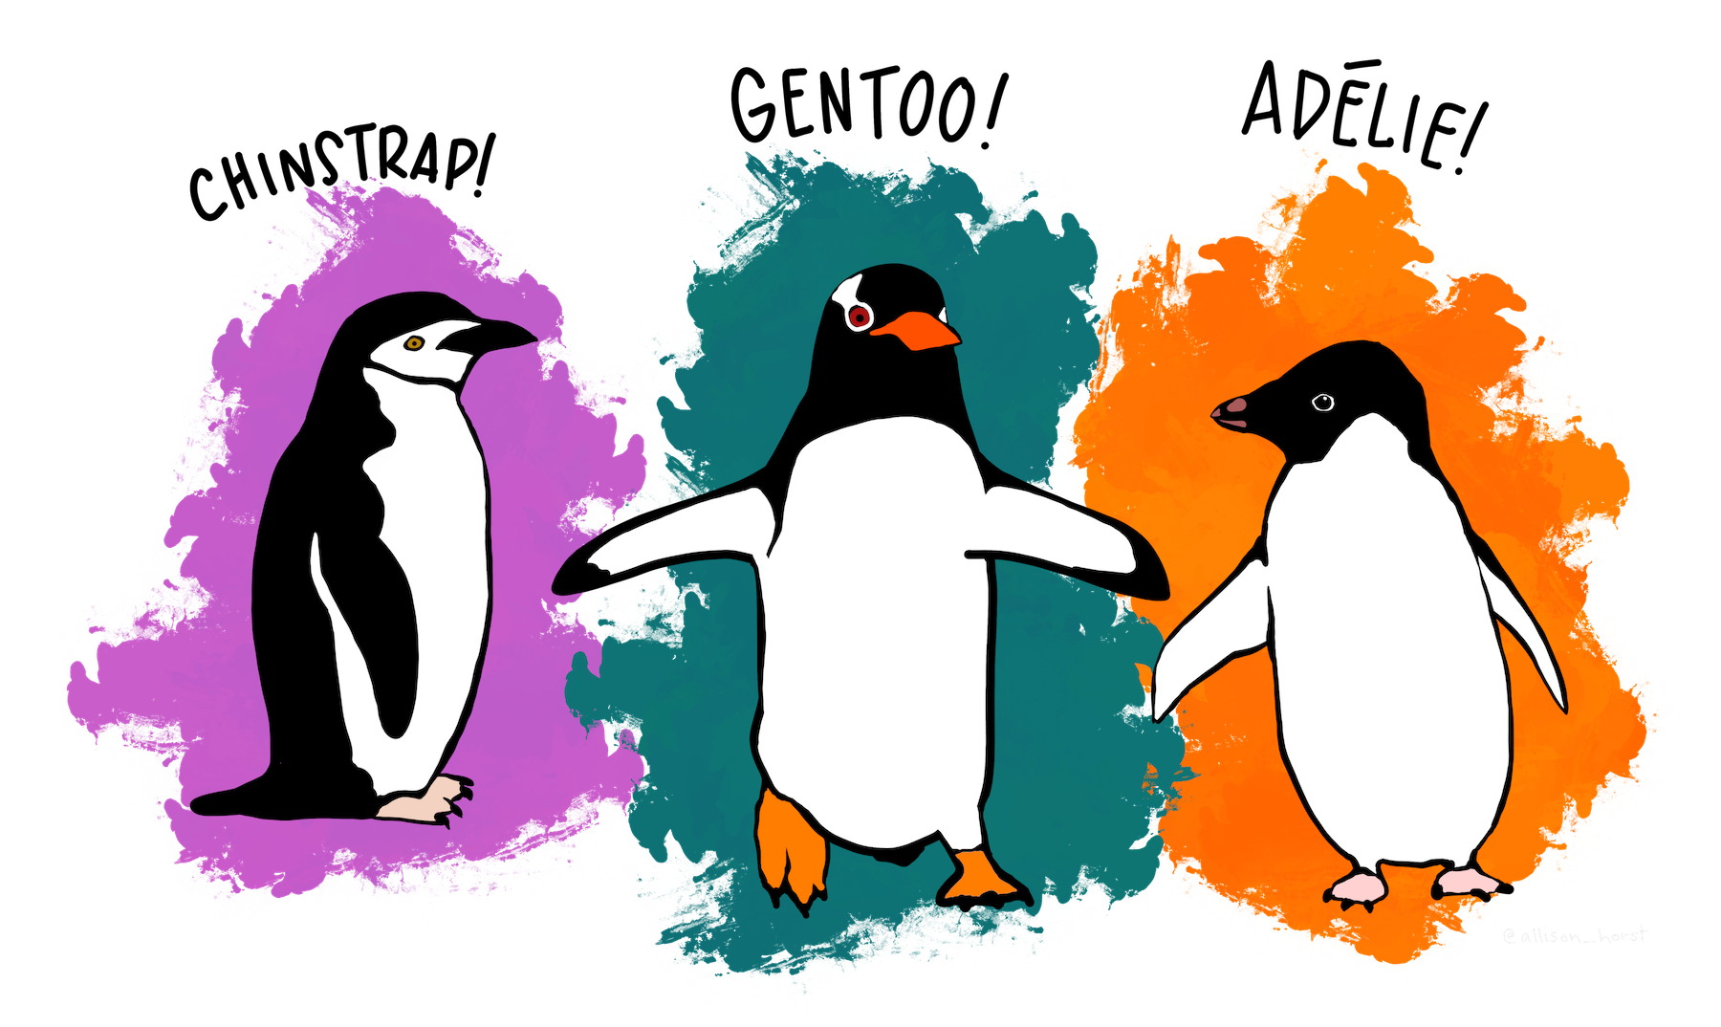

Palmer Penguin Dataset

Slide 30
We’ve got data. Find the signal! Data (pre-processing)
Finding patterns in the data
i.e. the technical characteristics of the data are less important than the pattern (model)
Input: some data
Methods: statistical analysis, machine learning, programming
Output: a robust, reproducible, generalizable model
Input
Pre-processing
ML model
[1] Accuracy – how well does the data reflect a real object/ event
[2] Completeness – are all mandatory/ necessary features present?
[3] Consistency – repeated entries/ consistent labels?
[4] Invariance in time – is the data outdated or a mix of old & new?
[5] Believability – the presented values are trustworthy
[6] Interpretability – the data and conclusions can be interpreted
Parametric/
non-parametric
Can handle continuous/
categorical vars?
Raw data

Slide 31
Data (pre-processing). Feature engineering Overview of concepts.
Input
Pre-processing
ML model
[1] Accuracy
[2] Completeness
[3] Consistency
[4] Invariance in time
[5] Believability
[6] Interpretability
[a] Understanding the structure of the data
type of features: continuous, categorical
ranges of features: [min, max], number of categories
missing information [labels, features]
discriminative power of features (redundancy)
[b] Adjusting data without tampering with signal
Expression ranges and One-hot encoding
Standardisation vs scaling
Near zero variance
Multi-collinearity
Dimensionality reduction
[c] creating robust models – cross-validation. Bias/ variance
Training/ Validation/ Test splitting
Cross-validation
Parametric/
non-parametric
Can handle continuous/
categorical vars?
Feature selection
Raw data

Slide 32
Next Lecture …
Applied Data Science L2. Learning from Data. Cross-validation. Data pre-processing

